Slide 1
Exercise: How many views?
IME 222ba – Orthographic Multiview Projections

Slide 2
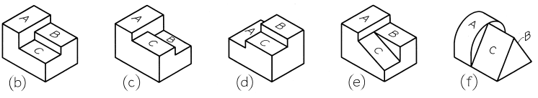
Exercise: How many views?
Match the following descriptions to the sketches below.
Surface B is highest, and A is lower than C
Surface A is highest, and B is lower than C
At least one surface is cylindrical
One surface is inclined
This exercise will make you think about the need for more than one view when representing objects using orthographic multiview projections.
ii
i
iv
iii

Slide 3
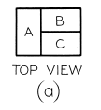
Exercise: How many views?
Now, think carefully before addressing problem II below...
Sketch the top views of the five objects shown in the previous slide. The objects are reproduced below for your reference:
All five objects have the same top view!
This means that more than just the top view is needed to properly represent these objects.
To avoid confusing the reader, orthographic multiview projections generally need more than one view. The views that are given should avoid potential ambiguity that may lead to misinterpretation of part features.

